Slide 1

Music Player using Linked List
21AIE111 – Data Structures and Algorithms (DSA)
Presented to
Mr. Ullas S
Srinidhi Kannan – BL.EN.U4AIE21121
Suryamritha M – BL.EN.U4AIE21126
Varshini Balaji – BL.EN.U4AIE21139

Slide 2
CONTENTS
Introduction
Objective
Literature survey
Block diagram
Functions used
Libraries used
Output
Conclusion
Reference

Slide 3
Introduction
Music Player plays digital audio files. This is a very organized way to listen to your favorite songs.
In this project, we have used a Doubly Linked list, which is a data Structure in Java for the implementation of this project.
This project involves various functions which include inserting front, inserting back, deleting front, deleting back, playing/pausing, displaying the songs in the Playlist, and stopping the song.
It also includes various Audio libraries in java for playing the song needed.
We have also created various classes wherein the audio files and be played. One of them is the scanner class for obtaining the input primitive types like int, double, string, etc.
The others are user-defined classes like music, Node dl, musicStuff, and many more for the implementation of the doubly linked list.
In this Music Player by entering the file path one can easily access the required song.

Slide 4
OBJECTIVE
Playing songs using doubly linked list.

Slide 5
LITERARY SURVEY
Pan Yong-Cai, Liu Wen-chao, & Li Xiao. (2010). Development and Research of Music Player Application Based on Android. 2010 International Conference on Communications and Intelligence Information Security. doi:10.1109/icciis.2010.28
Music player is a kind of common mobile terminal application. This paper takes a music player as an example to illustrate how to develop Android applications.
This player has a friendly interface, convenient operation, good expansibility and maintainability. After testing, the player can satisfy the basic demand of users and run stable.
Qing, Z., Ying, L., Yuan, P. G., & Sheng, L. Z. (2015). Music Player Based on the Cordova Cross-Platform. 2015 3rd International Conference on Applied Computing and Information Technology/2nd International Conference on Computational Science and Intelligence. doi:10.1109/acit-csi.2015.85
Cordova is one of the popular cross-platform mobile application development frameworks currently, with open source, free and at the same time, it supports multiple mobile operating system, etc.
This paper implements a simple music player quickly based on the Cordova framework using HTML + CSS + JavaScript, and developed my own Cordova plug-in, reduced secondary development, and adaptation for different platforms, and the instance provides a reference for the development of cross-platform mobile applications.

Slide 6
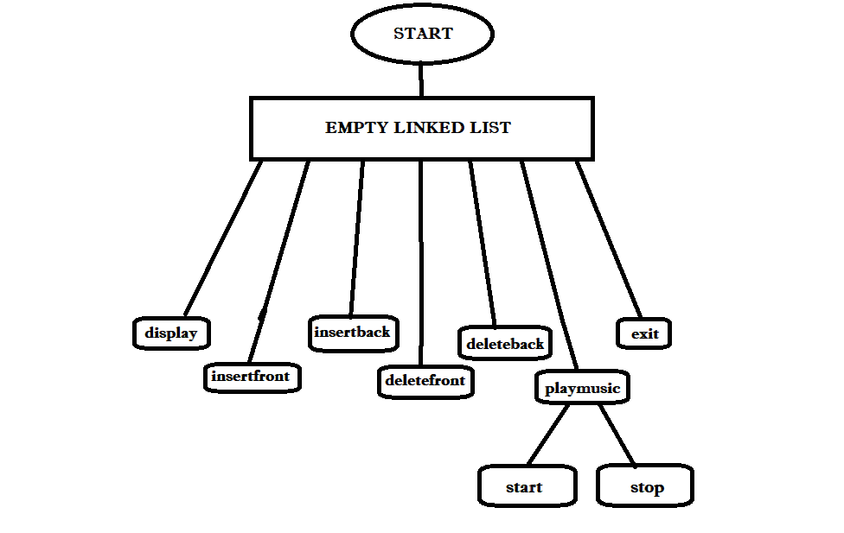
FLOW DIAGRAM

Slide 7
FUNCTIONS USED
Insert front
Inserts songs at the front
Insert back
Insert songs at the end
Delete front
Deletes songs at the front
Delete back
Deletes songs at the back
Playmusic
Plays the specified song in a loop and pauses the played song and continues back when asked
Display
Show all the available songs on the Playlist

Slide 8
LIBRARIES USED
java.util.Scanner
The Scanner class is used to get user input, and it is found in java. util package
java.io.File
The Java.io.File class is an abstract representation of file and directory pathnames
javax.sound.sampled.AudioInputStream
An audio input stream is an input stream with a specified audio format and length. The length is expressed in sample frames, not bytes.
javax.sound.sampled.AudioSystem
The AudioSystem class acts as the entry point to the sampled-audio system resources. This class lets you query and access the mixers that are installed on the system.
javax.sound.sampled.Clip
The Clip interface represents a special kind of data line whose audio data can be loaded before playback, instead of being streamed in real-time.
javax. swing. JOptionPane.
JOptionPane makes it easy to pop up a standard dialog box that prompts users for a value or informs them of something.

Slide 9
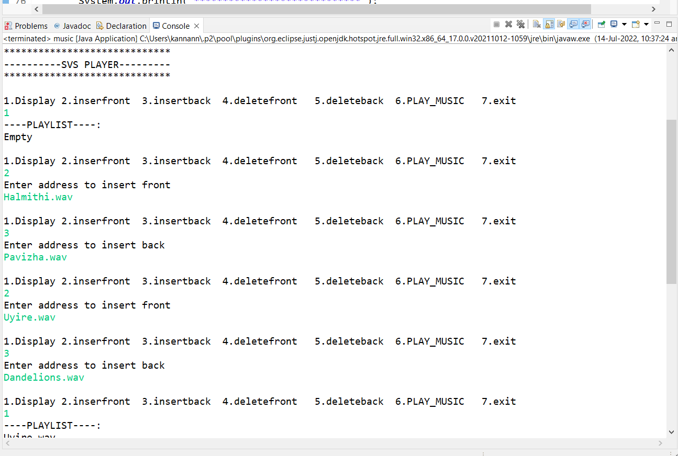
OUTPUT

Slide 10
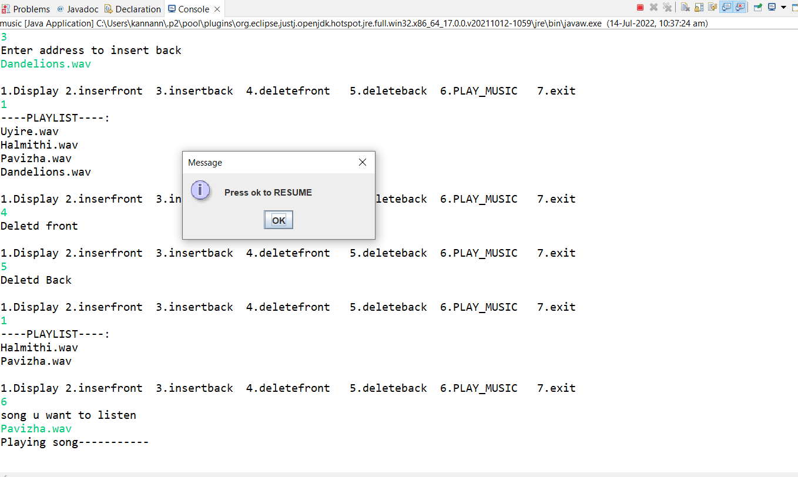

Slide 11
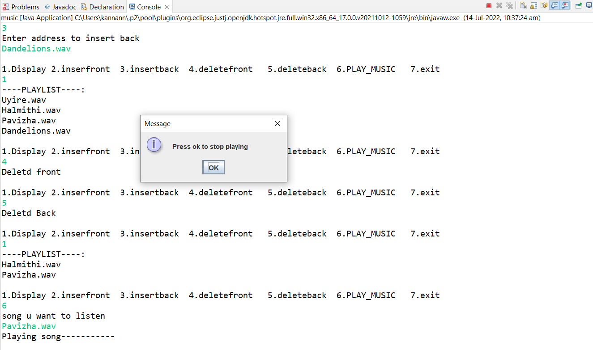

Slide 12
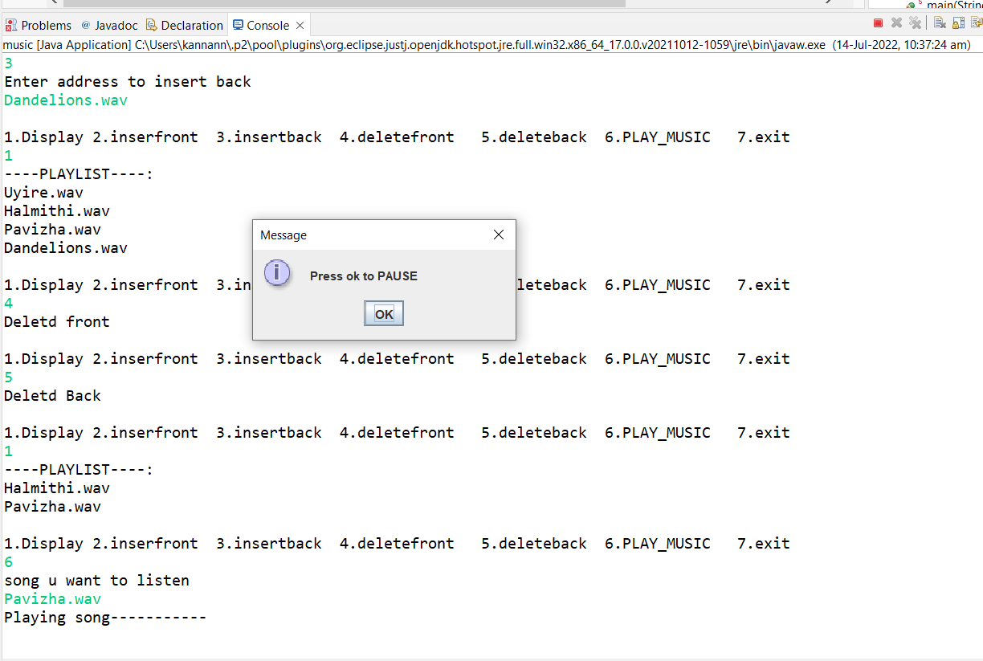

Slide 13
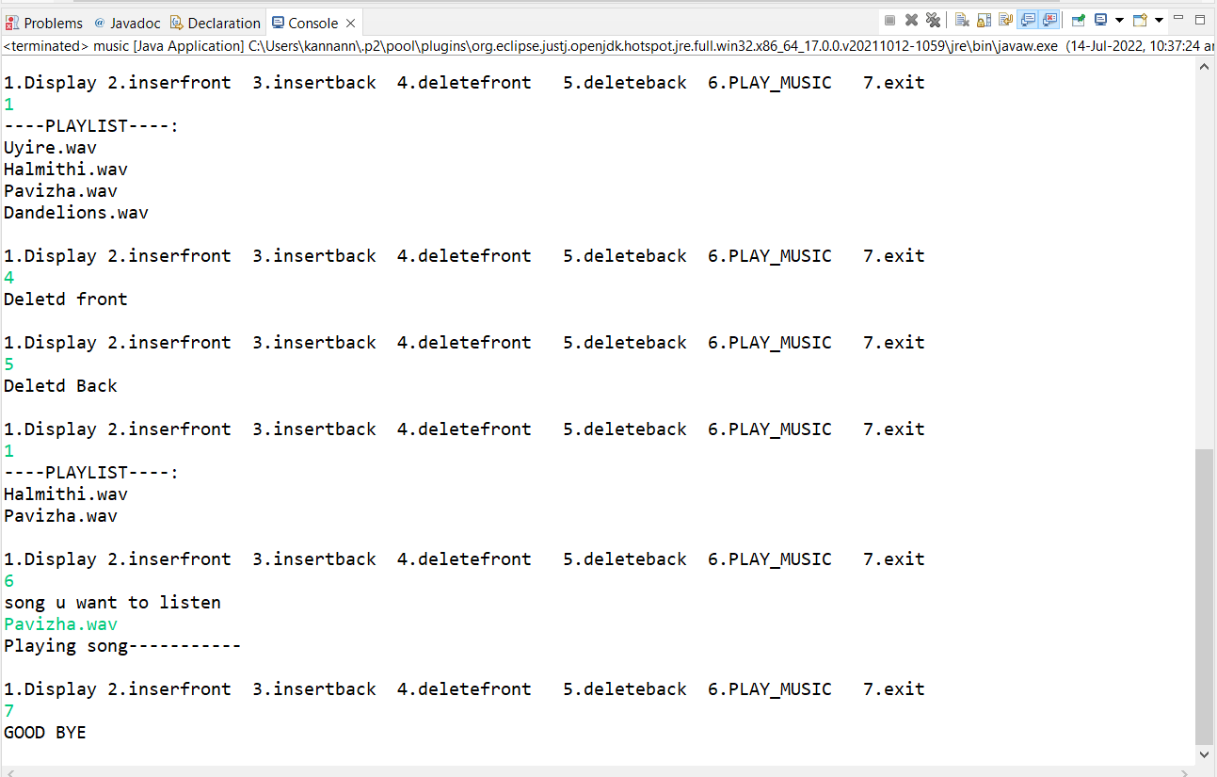

Slide 14
CONCLUSION
This project thus allows the user to listen to the song of their choice.
The doubly linked list makes the Music player, even more, better as deletion of the node is easier and the insertion can be performed efficiently at any node.
When you add a new track to a playlist, you tack it on to the end. In a linked list, adding a new element is a constant time — O(1) operation.
Note that as the songs are read in from a data source and added to the playlist, this will be done as a sequence of calls to append.
A linked list has head and tail properties, this provides for an easy way to delineate the beginning and end of a playlist.
Future Scope
The project can be made as an APP making it available for all. It will integrate the advantages of existing music players on the market. We can have numerous options like a change of screen modes (drive mode and night mode), a trim option to trim the favorite part of the music, and many more making it user-friendly.
We can also implement a music player based on the mode of the users.

Slide 15
REFERENCE
https://docs.oracle.com/javase/8/docs/api/javax/sound/sampled/package-summary.html
https://www.youtube.com/watch?v=TErboGLHZGA
https://mobcup.net
Online Audio Converter - Сonvert audio files to MP3, WAV, MP4, M4A, OGG or iPhone Ringtones (online-audio-converter.com)
Pan Yong-Cai, Liu Wen-chao, & Li Xiao. (2010). Development and Research of Music Player Application Based on Android. 2010 International Conference on Communications and Intelligence Information Security. doi:10.1109/icciis.2010.28
Qing, Z., Ying, L., Yuan, P. G., & Sheng, L. Z. (2015). Music Player Based on the Cordova Cross-Platform. 2015 3rd International Conference on Applied Computing and Information Technology/2nd International Conference on Computational Science and Intelligence. doi:10.1109/acit-csi.2015.85

Slide 16
THANK YOU !!!

